Slide 1

Autonomous Crop Row Detection for a Laser-based Weeding Robot
Roxane Mérat
Semester Project
Supervisors :
Cornelius von Einem
Patrick Barton
Prof. Dr. R. Siegwart

Slide 2
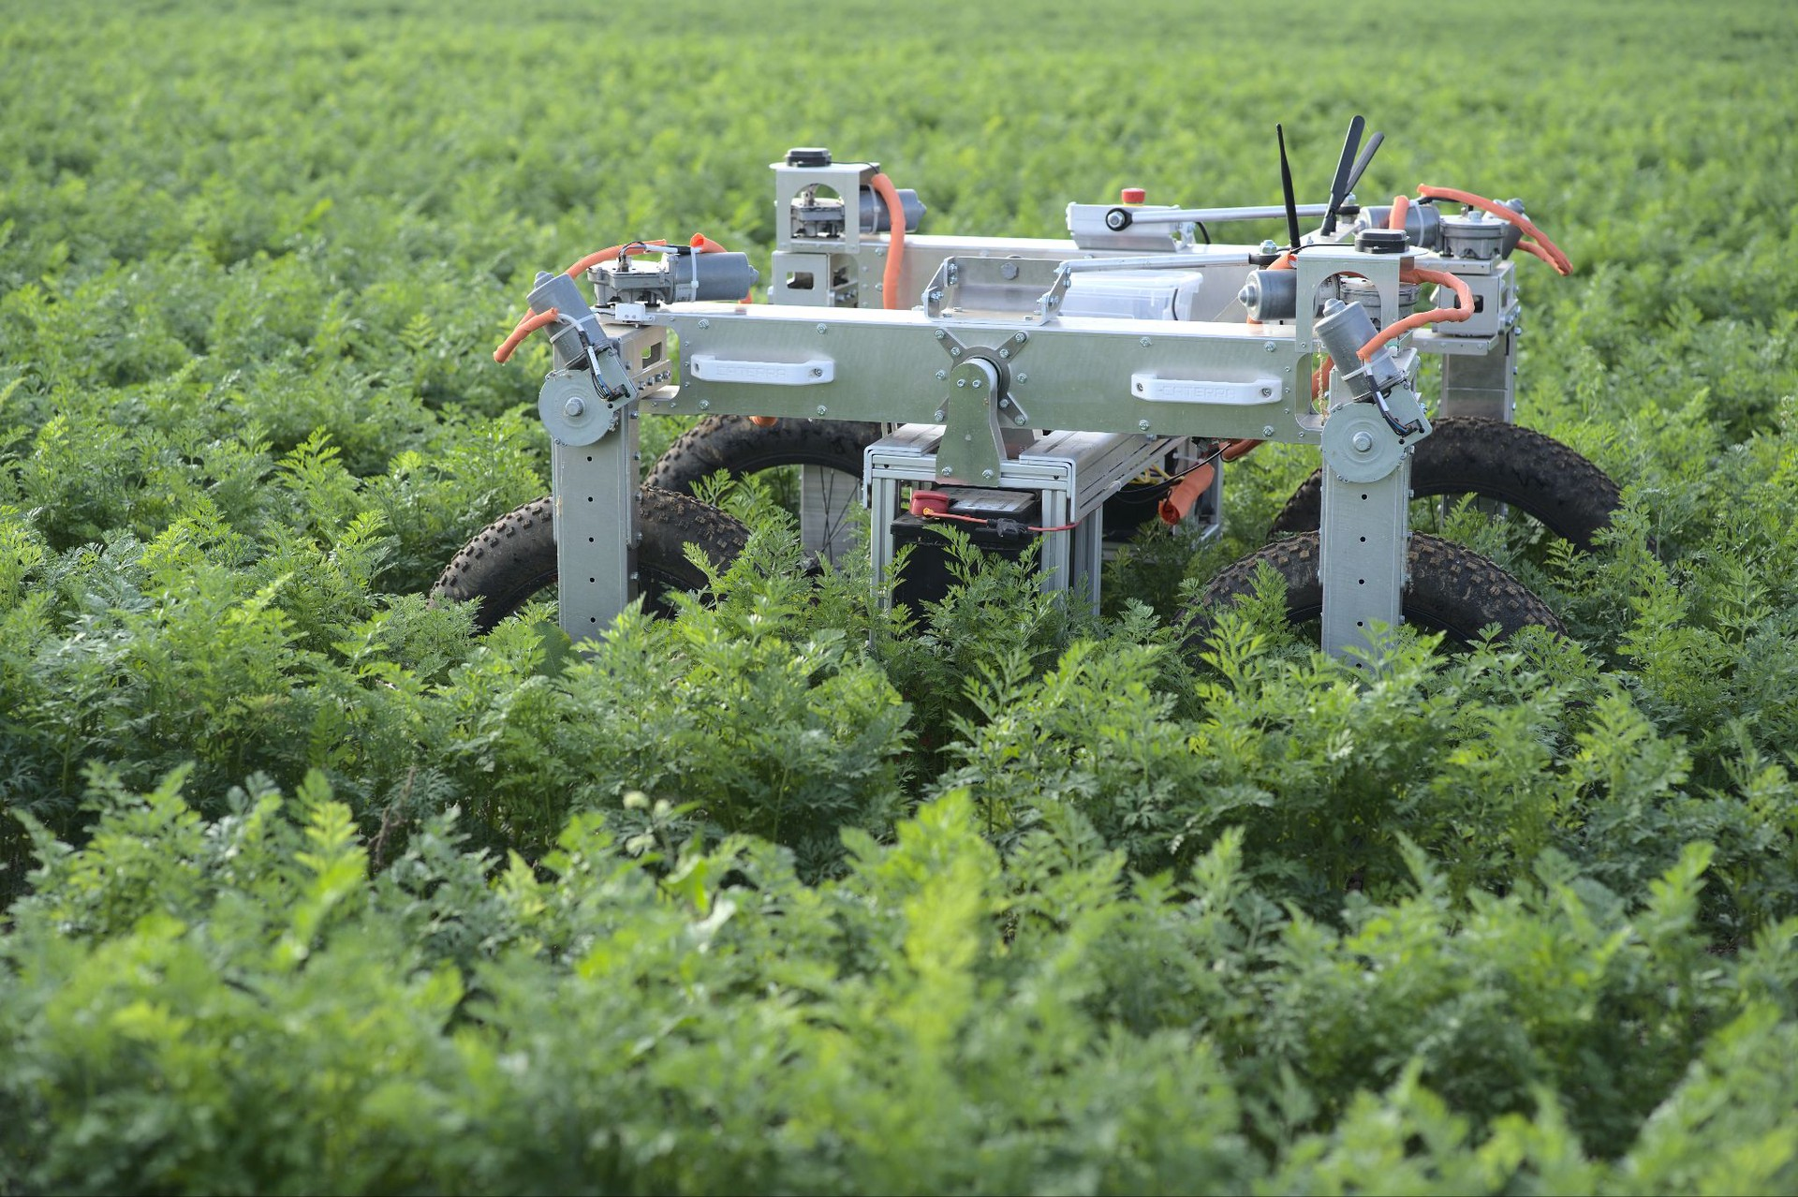
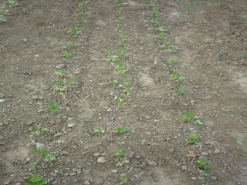
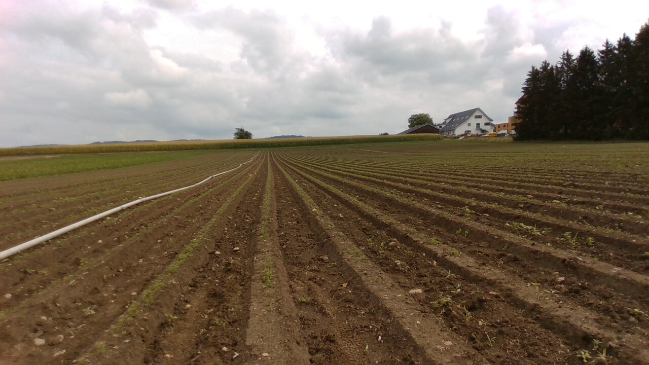
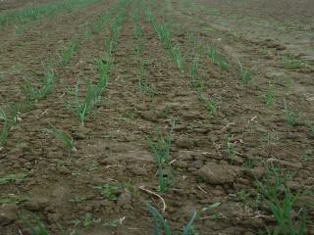
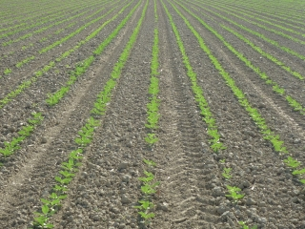
The Caterra Project
Goal of Caterra :
Develop an autonomous agricultural robot with a laser module for weed removal
My goal :
Develop a robust crop rows detection algorithm using computer vision
Caterra’s agricultural robot

Slide 3
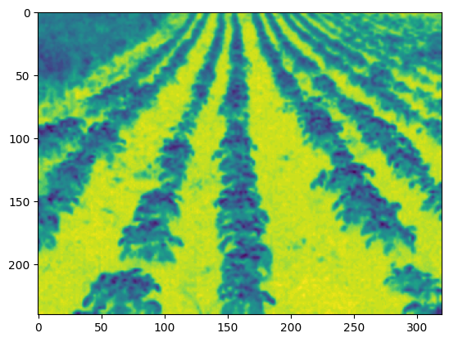
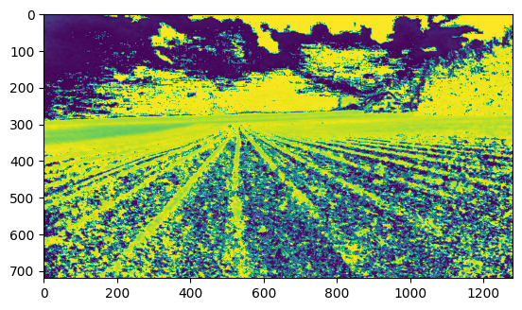
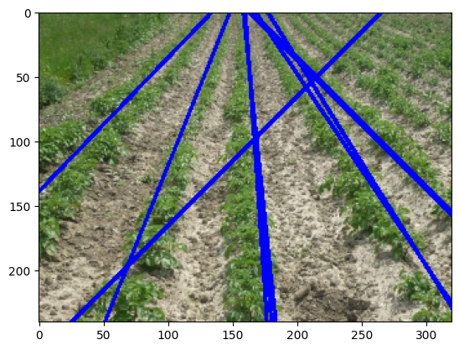
State of the art
Excess green Index
Hough transform [1]
Deep Learning [2]
Excess green index images
Hough Transform results
[1] : Real Time Tracking of Plant Rows Using a Hough Transform, John.A Marchant and Renaud Brivot
[2] : “From plants to landmarks: Time-invariant plant localization that uses deep pose regression in agricultural fields”, Kraemer et al.

Slide 4
Algorithm
Image
Image Pre-processing
Constrained Hough Transform
VP Calculation
Constrained RANSAC
Next Image
No
Is the error too big?
Yes
→ Use of temporal information : a crop should be in the same region in two sequential frames

Slide 5
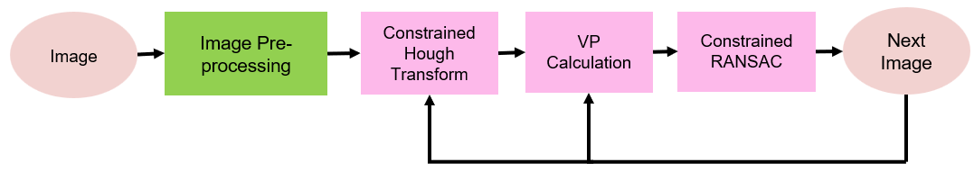
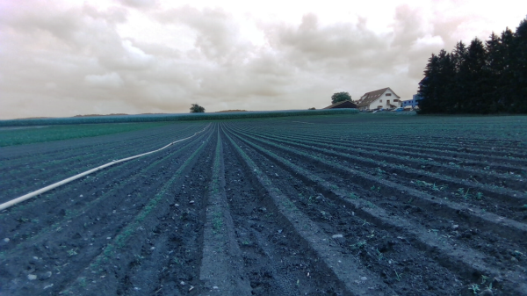
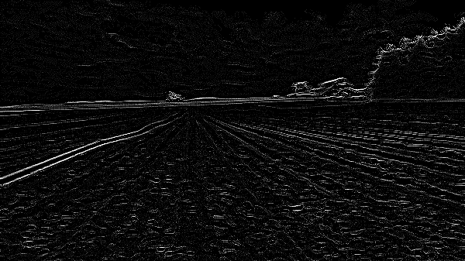
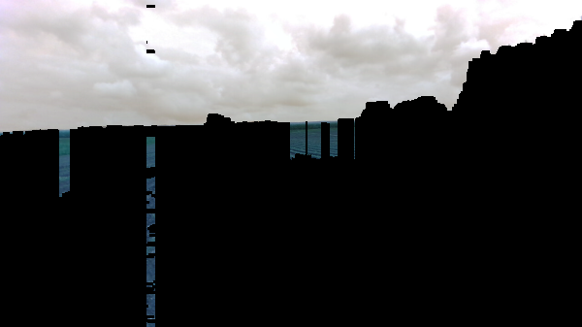
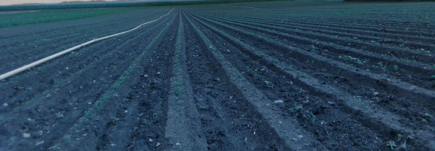
Sky Removal
Original Image
Calculate Laplacian
Image with sky cut-off
Mask of the region with high Laplacian

Slide 6
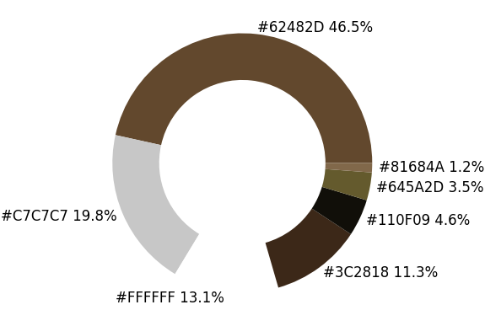
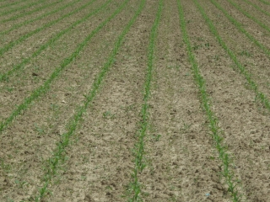
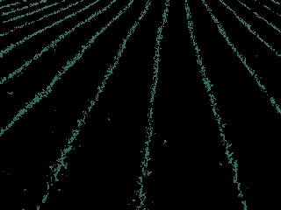
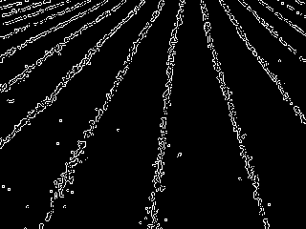
Vegetation Segmentation
Advantages :
Threshold independent
Robust to shadows and colour variation
main clustered colours
Original Image
Vegetation segmented
Canny Edges Detector

Slide 7
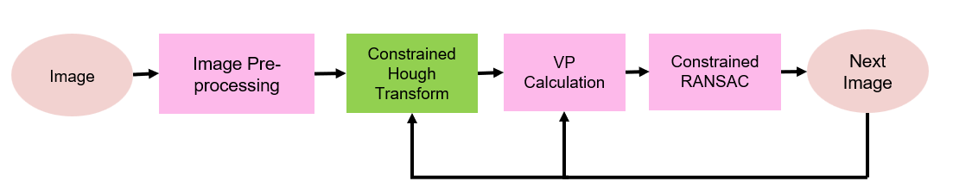
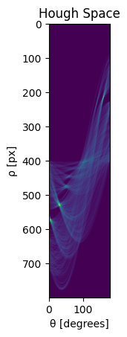
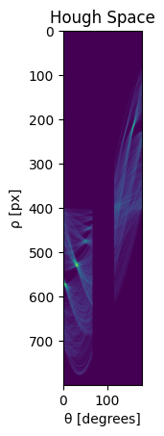
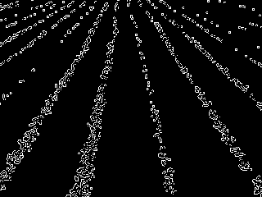
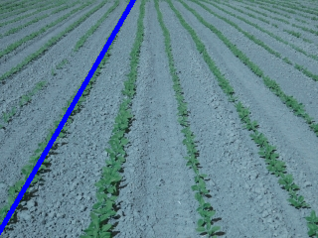
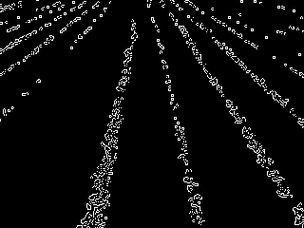
Constrained Hough Transform
Image in Hough Space, the maximum value is taken
New Hough Space, band around detected angle
Vegetation Image
New masked image to be process
Line Detected

Slide 8
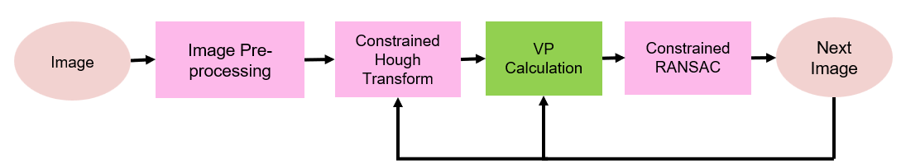
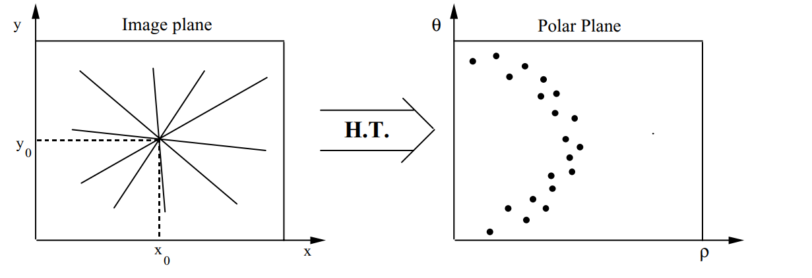
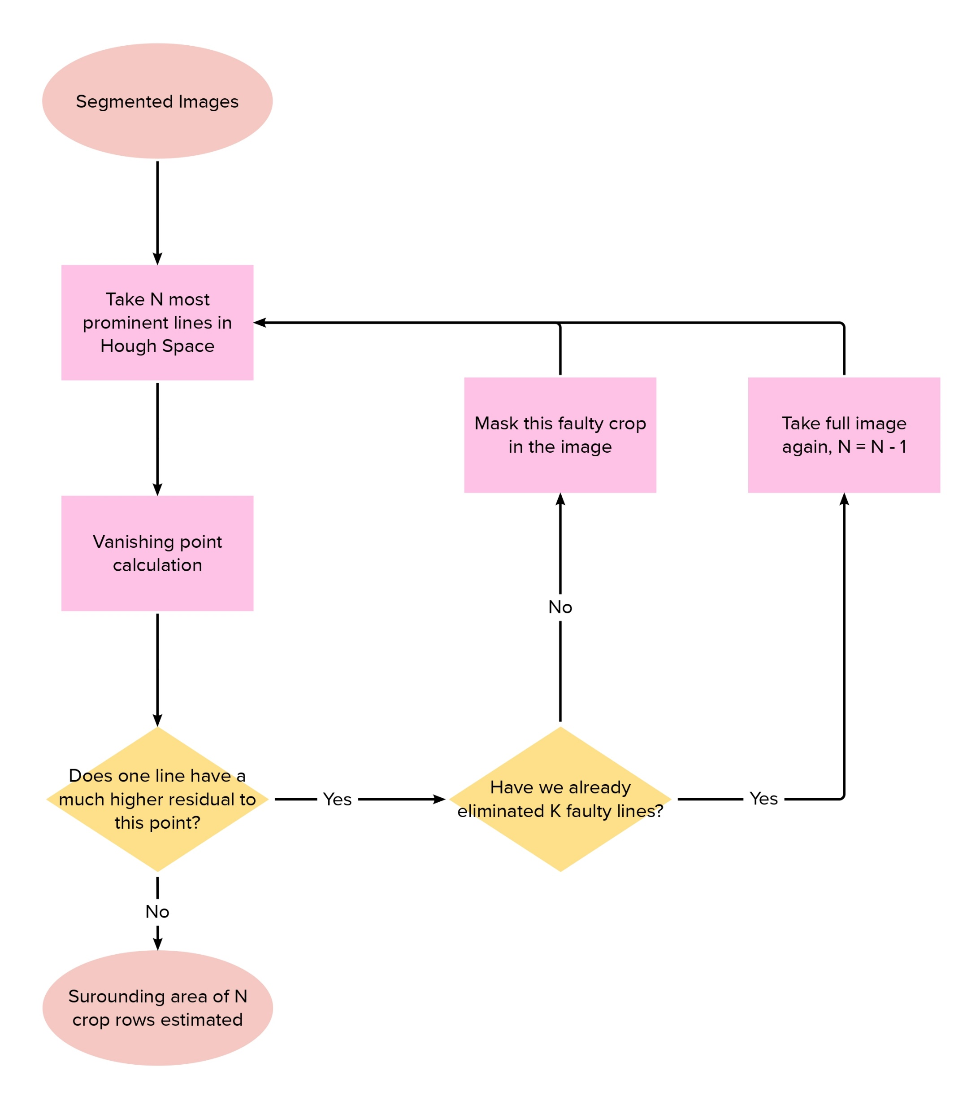
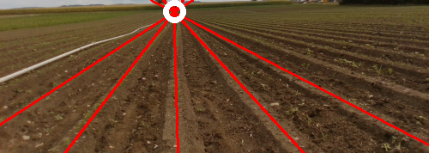
Vanishing Point Calculation
Vanishing point = point described by main sinusoidal in Hough Space
Hough Transformation of a set of lines that intersect in a single point [1]
[1] : Vanishing Point Detection in the Hough Transform
Space, Andrea Matessi and Luca Lombardi

Slide 9
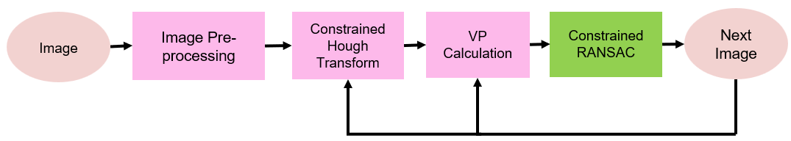
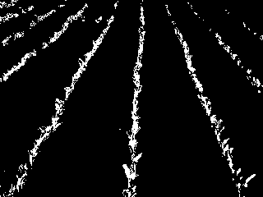

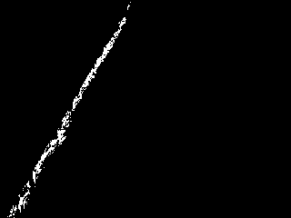
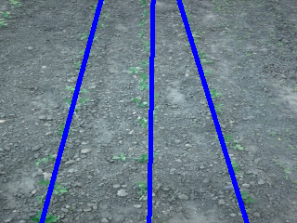
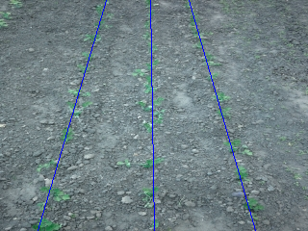
Masking per crop
Vegetation Image
Mask
Crop Row masked
Each previously detected line is used to create the mask that will isolate the pixels corresponding to a single crop row in the next image
Lines found with Hough
Lines found with RANSAC

Slide 10
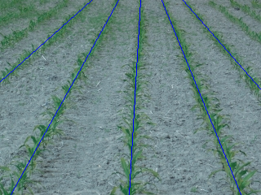
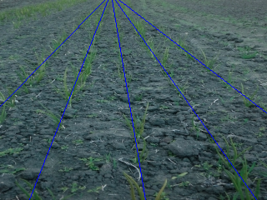
RANSAC Lines
Detection with Hough Transform :
Every K frames
If distance between crop row too small
If angle too close to the horizon angle
If too few points for RANSAC

Slide 11
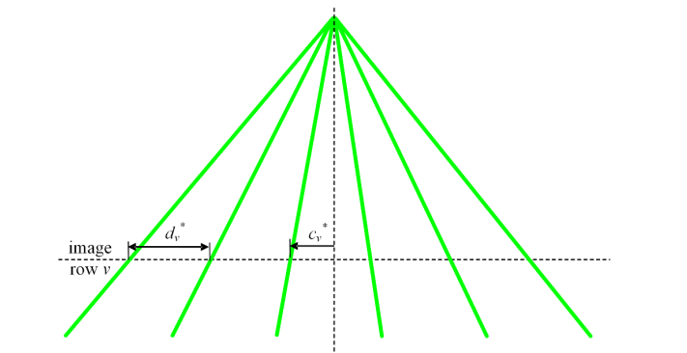
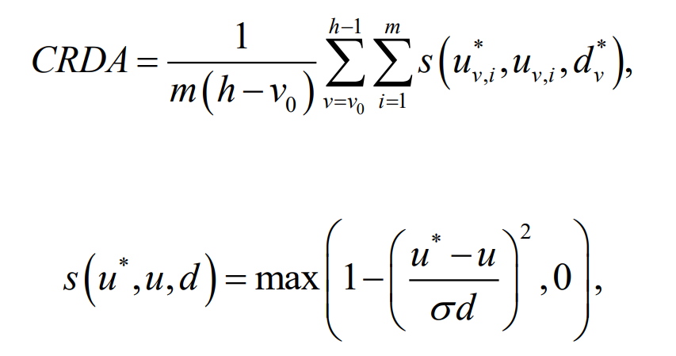
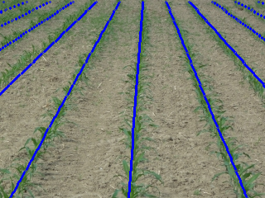
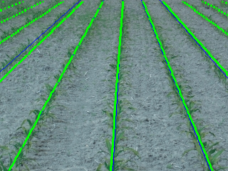
Evaluation
Values [1] :
m – number of crop tbd
v0 – first line where evaluation starts
h – height of the image
u* – ground truth point on line v
u – my results of point on line v
d – distance between crops
σ – desired accuracy needed, 0.25 in my case
[1] : Method proposed by Vidovic et al., http://www.etfos.unios.hr/r3dvgroup/index.php?id=crd_dataset

Slide 12
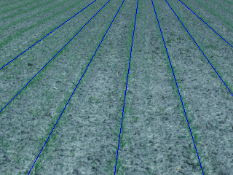
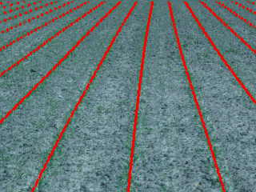
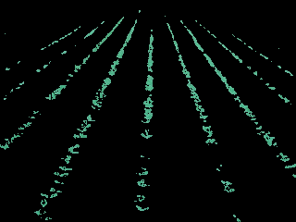
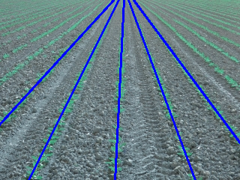
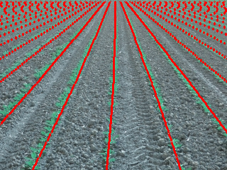
Results (1) :
Original Image
Vegetation segmented
Results
Ground Truth
Score = 0.98
Score = 0.92
Original Image
Vegetation segmented
Results
Ground Truth

Slide 13

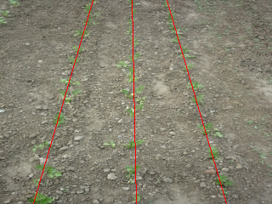
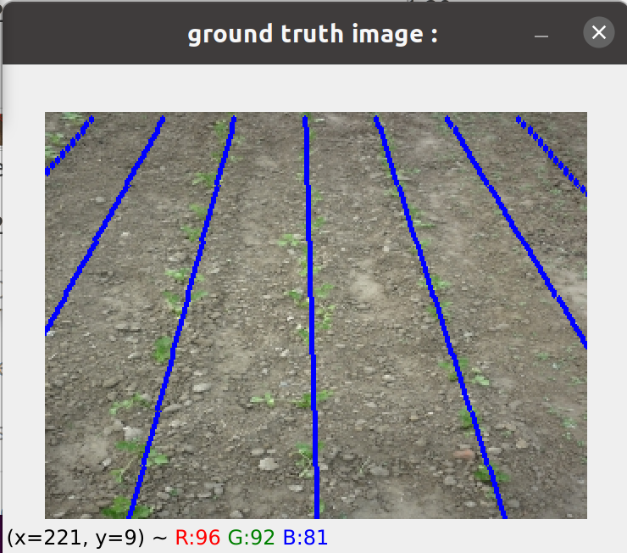
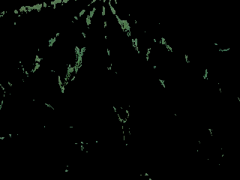
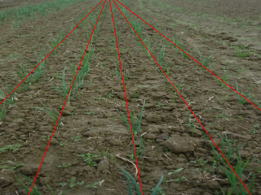
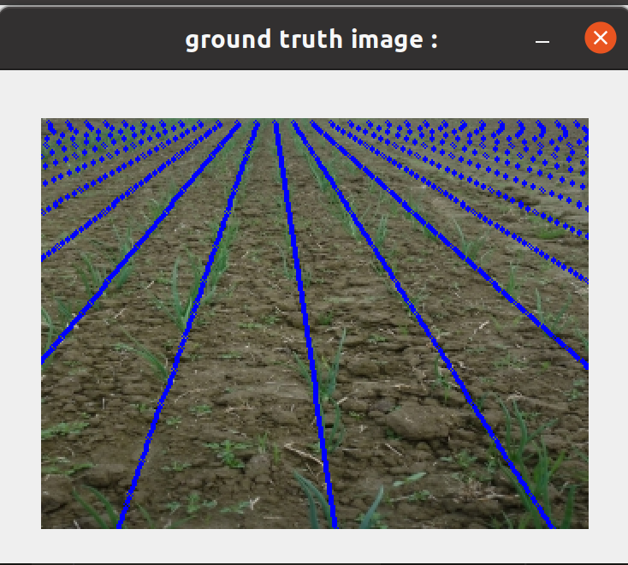
Results (2) :
Original Image
Vegetation segmented
Results
Ground Truth
Score = 0.93
Score = 0.85
Original Image
Vegetation segmented
Results
Ground Truth
On complete dataset : average score of 0.92 for non bushy images, 0.6 for bushy images

Slide 14
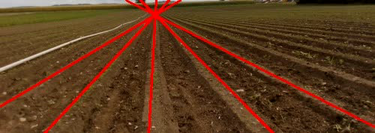
Results (3)
Result of Caterra’s Dataset

Slide 15
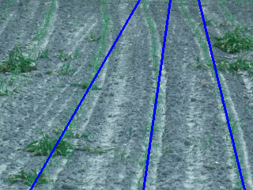


Failure Cases
Detection of curved crop rows
Very bushy crops

Slide 16
Future Work
Optimize the code
Test it on different datasets : different soils and weather conditions
Calibration process

Slide 17
Conclusion
Robust to different illuminations, points of view
Generalisable : not limited to one kind of plants
Accurate for straight crop row
Bushes can be a problem
Too slow, not yet able to work in real time

Slide 18

Thank you !

